Slide 1
Konark: A RFID based system for enhancing in-store shopping experience
Swadhin Pradhan¹, Eugene Chai², Karthik Sundaresan², Sampath Rangarajan², and Lili Qiu¹.
¹UT Austin ²NEC Labs America
Notes:
Good morning everyone ☺ Thank you for the introduction .. If any.. I will be presenting our paper titled Konark.. Which is a joint work with my advisor Lili and Karthik, Eugene, and Sampath from NEC labs America ..

Slide 2


Motivation
Immersive
Personalized
Faster …
More Insights
Fine-grained ..
Consumer
Retailer
Notes:
There are two major players in any retail scenario : the consumers and the retailers. In the current physical retail setup, both of them are wanting to get more out of their experience. Consumers are eager to get more immersive and personalized experience, and they hate the delay at the end of it. Retailers are wanting to get fine-grained insights (just not the purchase history).

Slide 3






Overview
Creating a RFID based system to provide
Better consumer shopping experience
Richer retail analytics
Queue-free checkout
Items bought?
Items interested ?
Which items customers put in the cart
at a particular time window ?
Detecting which items users are browsing
Notes:
In our work, we try to address most pressing issues ailing the brick-and-mortar retail industry. We build a RFID based retail cart to provide better consumer shopping experience and richer analytics. RFID (Radio frequency identification) JC Penny, Zaras, Target etc. use it.

Slide 4
Our Work
Building a RFID reader and antenna equipped
shopping cart and
developing algorithms to detect items inside the cart,
and to detect users’
browsing interests on-the-go.
Notes:
More specifically, we build a reader and three antenna equipped RFID cart prototype.

Slide 5
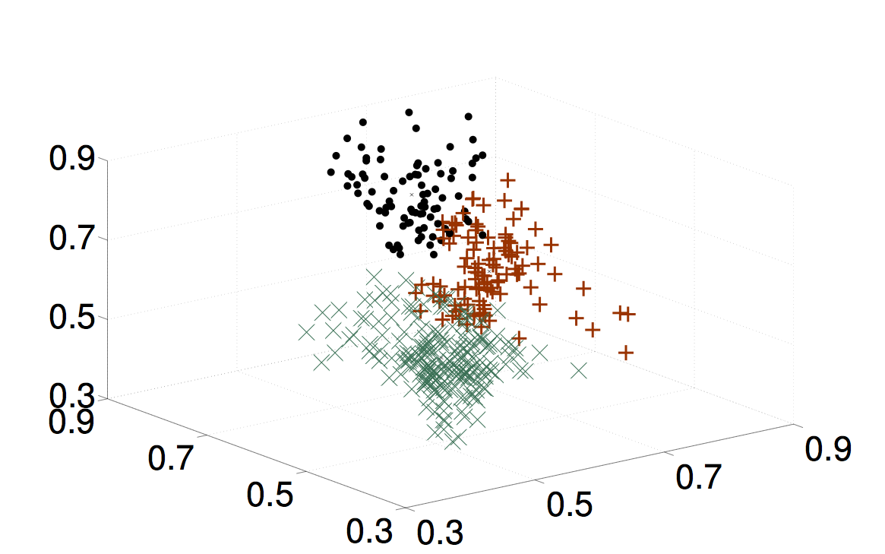
Detecting Items Inside the Cart
Reference
Tags
Key idea
Algorithm sketch:
Time
Hi-dimensional Feature Space
Tag IDs
Yes
K-Means Clustering
Cart is Mobile ?
Feature Values
Notes:
Here, I outline the algorithm we use in the The key idea, we exploit, is the mobility of the user and the limited reading range of RFID antennas. We also exploit the fact that the features like RSSI, Phase, Read rate, doppler frequency change of RFID tags of in-cart will be different than outside tags. We also use the fact that in-cart items change less frequently compared to out-cart items. For example, when user moves the reading zone changes and the features shown by the tags of different ta In-cart tags would be similar.

Slide 6
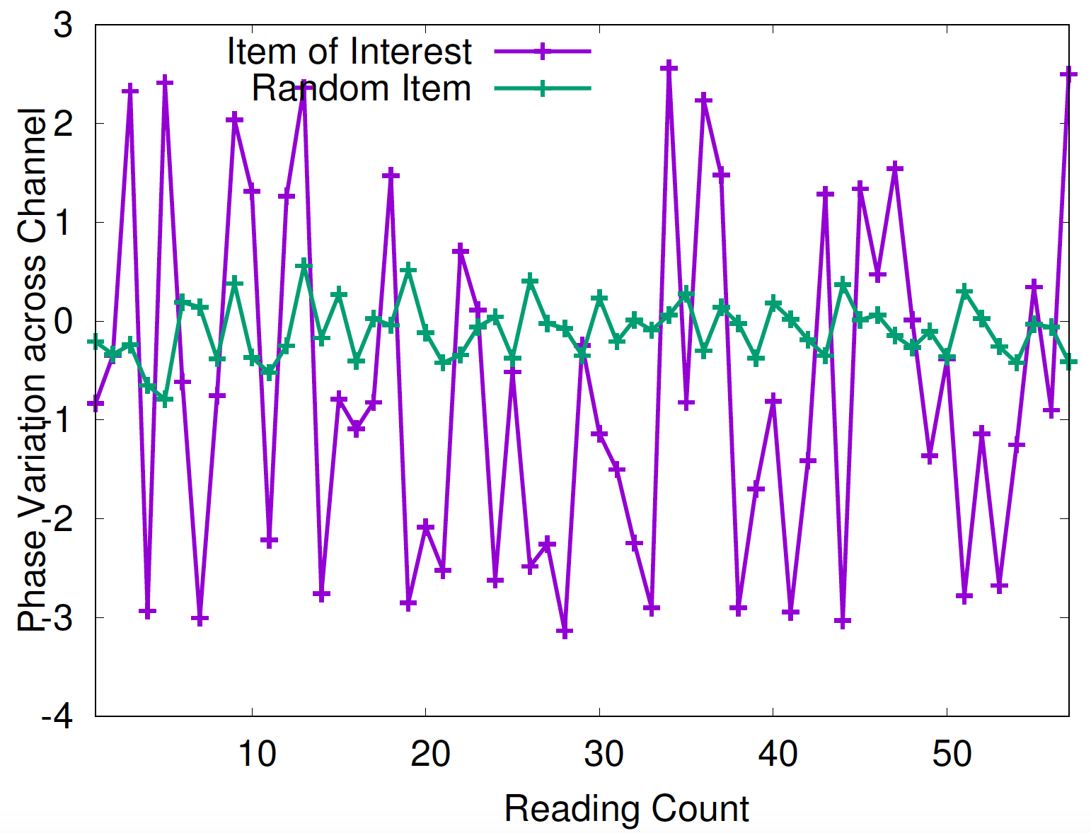
User’s Item Browsing Detection
Key idea :
The phase variation of the tags of
interacted items is higher.
Algorithm sketch:
Cart is Mobile ?
Track phase variation
across tags
No
Filter tags according to
nearest reference tags
Find the tags with highest
phase variation
Notes:
We observe the when user pick up the item there is a huge phase variation of the item.

Slide 7
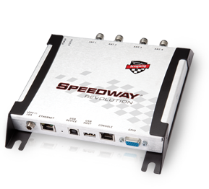
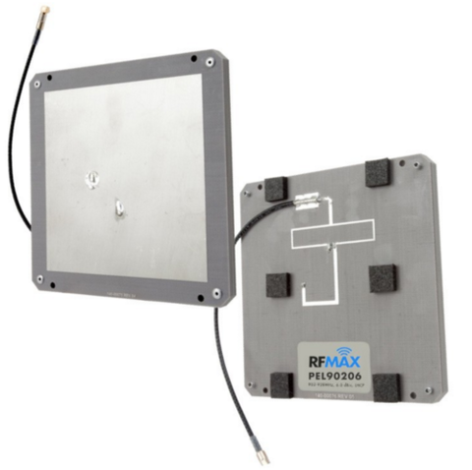

Setup
Impinj Speedway Revolution RFID Reader
Reads phase, RSSI, doppler of RFID tags
300 tags/second
50 channels, 902.75-927.75 (25 MHz bandwidth)
6 dBi gain circular polarized Antennas
Dogbone Monza 6 RFID tags
(Suited for 866-928 MHz reading)
Notes:
We used the following equipment in our experiments

Slide 8
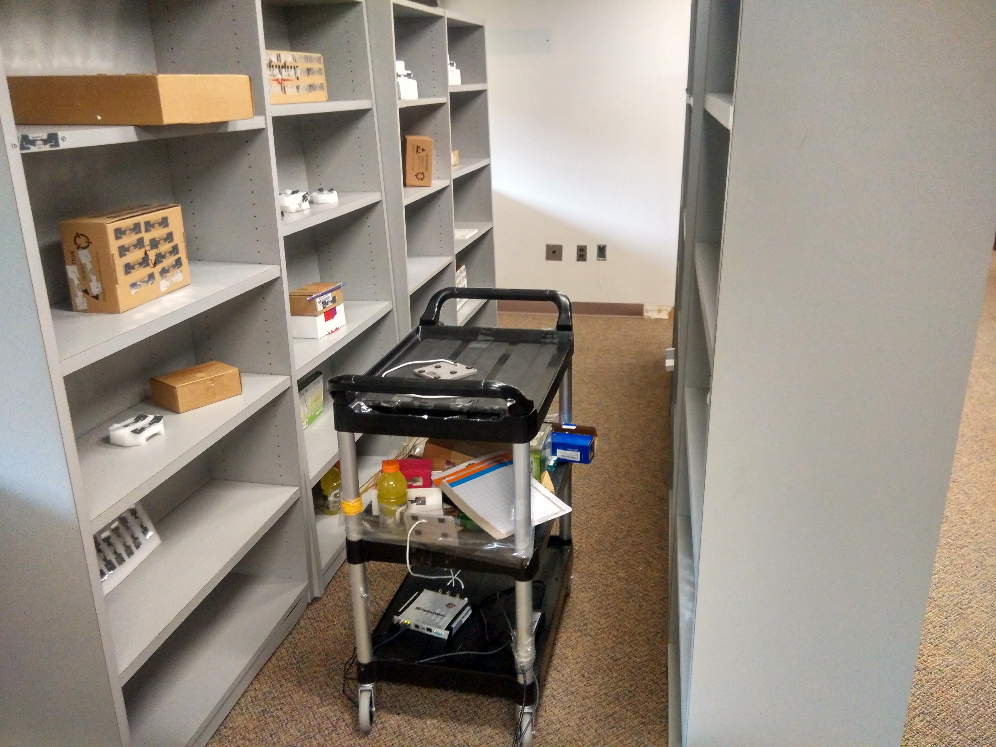
Experimental Setup
Reference Tags
Laptop
The Cart
Antennas
RFID Reader

Slide 9
Evaluation metrics
Modules :
Detecting items inside the cart.
Detecting user interest in a particular item.
Metrics :
Accuracy (What percentage of items predicted correctly ?)
False Positive % (What percentage of items are outside but tagged inside ?)
False Negative % (What percentage of items are inside but tagged outside ?)
Detection Latency (How much time it takes to detect ?)
Notes:
These are the metrics.

Slide 10
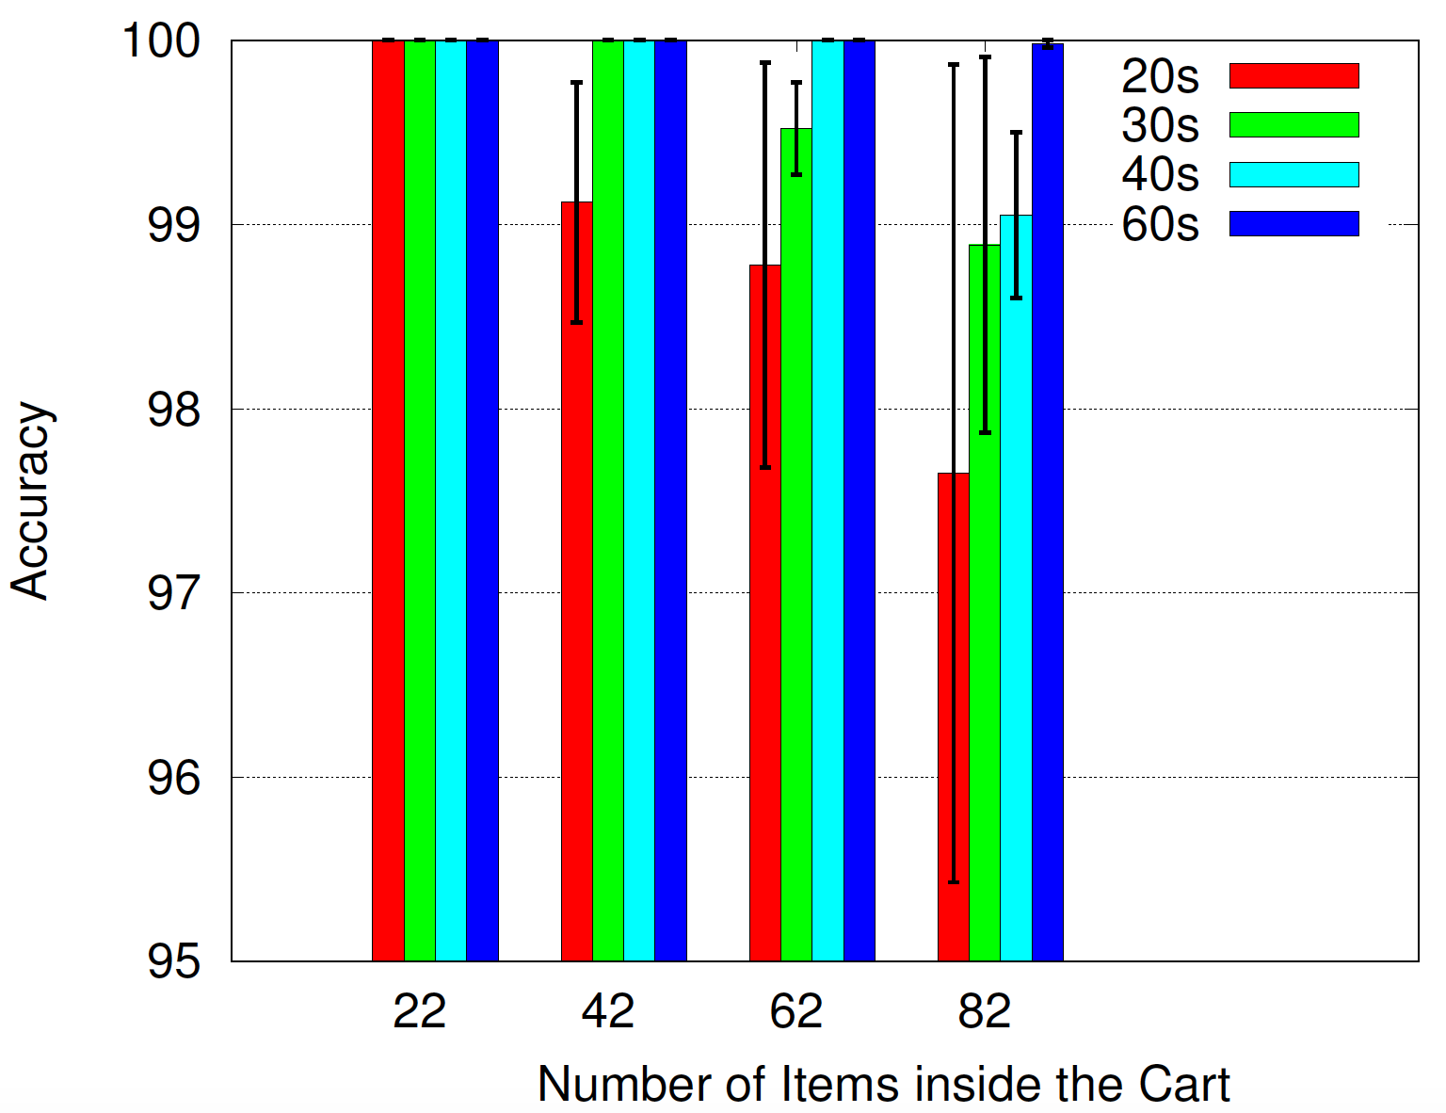
In-cart item Detection Accuracy
Accuracy reaches ~100% after
Detection latency of 60 seconds
Accuracy remains good even
after putting many items in the cart

Slide 11
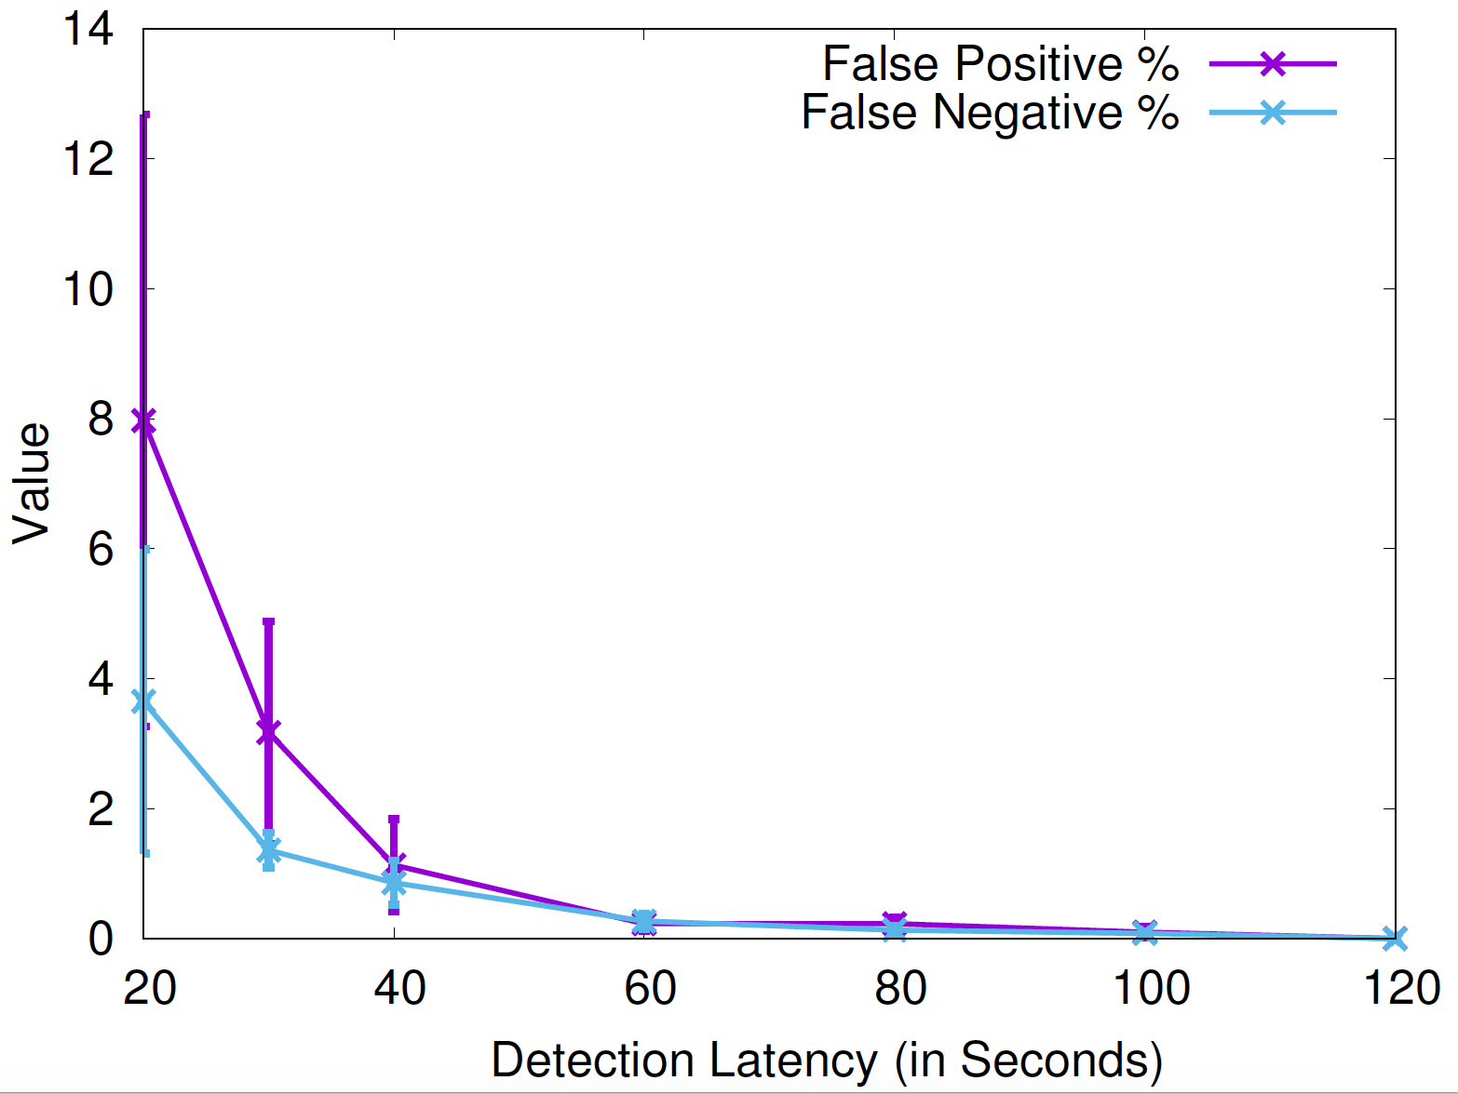
Detection Latency vs Accuracy
False positive rate is not too high
even in low detection latency
and high number of items
Notes:
Detection latency.

Slide 12
Item Browsing Detection
For number of items ~ 200,
to achieve ~100% accuracy,
we need only ~20 sec latency.

Slide 13
Key takeaways
Trade-off between detection latency and accuracy.
Speed and benefits compared to traditional self-checkout system or vision based system (Amazon Go). (NLOS/Occlusion).
Infrastructure RFID solutions (ShopMiner [SenSys ‘15] or CBID [Infocom ‘14]) which work with smaller number of tags, and lacks user level information.
Notes:
Key takeaways are thes

Slide 14
Future Works
Making the retail analytics richer.
Testing with multiple carts at different mobility.
Collaboration among shopping carts etc.
Field-testing the system in real shopping malls.
Notes:
These and many are left for future work

